Slide 1
Green IT Governance

Slide 2
INTRODUCTION
Green process management matures as proper business governance which align with performance governance, project governance, change governance, and IT governance and control is applied to it.
An idea way to do this is to incorporate green aspects within the existing governance structure within the organization.
Governance standards bring together legislation, regulation, industry standards, contract agreements, and internal together in a synergy. A standards influence in both the manual processes used by individual within the organization, and the software system and application with business embedded business rules.

Slide 3
IT governance indicates how governance standard is translated into policies and practices through business rules. A business rules also apply to external and, particularly, collaborative business processes are also carbon compliant.
Green organizational policies require business rules. A business rules are either embedded electronically or followed manually. These business rules have a wide-ranging influence on both the manual processes used by individuals within the organization, and the software systems and applications with business embedded business rules.
Whether business rules are embedded within the application software or not, such business rules still have a bearing on the requirements. Therefore, there is a need to correlate policies to rules to requirement.
When it comes to building, data centers , communications, and networks infrastructure ,the most commonly used governance standard is the Information Technology Infrastructure Library(ITIL) also known as Infrastructure Management Service (IMS).

Slide 4
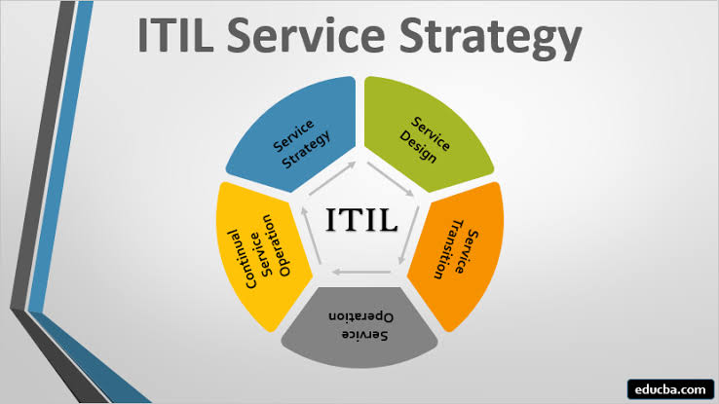
INFORMATION TECHNOLOGY INFRASTRUCTURE LIBRARY (ITIL)

Slide 5
SERVICE STRATEGY
Service Strategy provides guidance on explanation and prioritization of service provider and their customers' investments in services . A service strategy should have so me "Green" factor embedded into them and this can influence the way in which an organizations IT services are provided, with green factor introduced, this is even more influential. It is service strategy influences the service providers as well as service consumer.

Slide 6
SERVICE DESIGN
Service Design-provides guidance on design of new or modified IT services through a catalogue. A design of each service can be based on the Green IT policies and practices, thereby ensuring that the systems and applications consuming these services have an implicit green angle to them. Customer input can be used in these service designs to ensure that they cater for the ever increasing demands of the customer for green service.

Slide 7
SERVICE TRANSITION
Service Transition-facilitates transition of a service to the operational area of the business with environmental considerations inbuilt into them . It is requires proper planning and controlled changes to the services. It is a unit-level change to the overall changes in business processes of the organization with a delta change toward "Green”.

Slide 8
SERVICE OPERATION
Service Operation-is when the service has become operational and can be called "Green Service" when the environmental considerations are taken into effect. These are typically the web services based activities of a business process and, therefore, have to be measured for their carbon impact during operation. An ITIL guidance in monitoring the service during operation including recording faults during operation can be extended to calculate its carbon impact.

Slide 9
CONTINUAL SERVICE OPERATION
Continual Service Improvement-provides guidance on the things that need to be controlled and measured for improving service quality, particularly from a green business perspective. Continual Service Improvement in ITIL deals with engaging IT and business management in an ongoing dialog. Such dialog would also provide measurements for service availability, reliability, and performance and reporting.

Slide 10

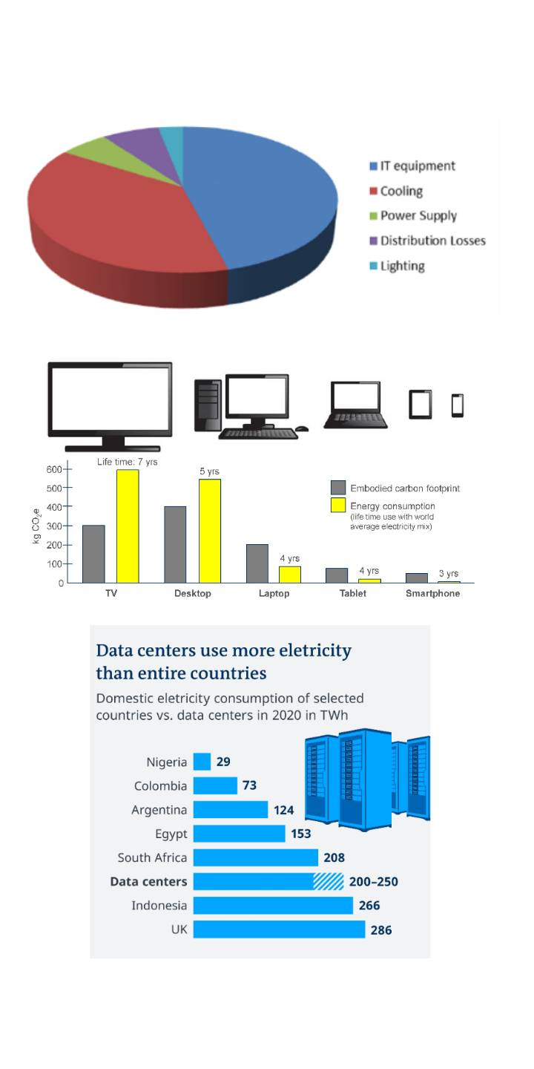
WANT BIG IMPACT?
USE BIG IMAGE.

Slide 11
Business Policies , Rules , and Process Requirements
Green Business Policy | Corresponding Business Rule Description | Green Business Purpose
Reduce Data Center | Make extensive use of Cloud computing to shift the data center activities and resources. | Effective reduction in emissions due to consolidation of data center resources on the Cloud
Increase Carbon awareness in products and services | EPEAT style labeling of products and services resulting from the organization | Carbon value calculations appearing on products and services can assist the customers in choosing products that are low in carbon.
Reuse and recycle | Reuse equipments through their entire lifecycle | Reduces emissions and electronic wastage

Slide 12
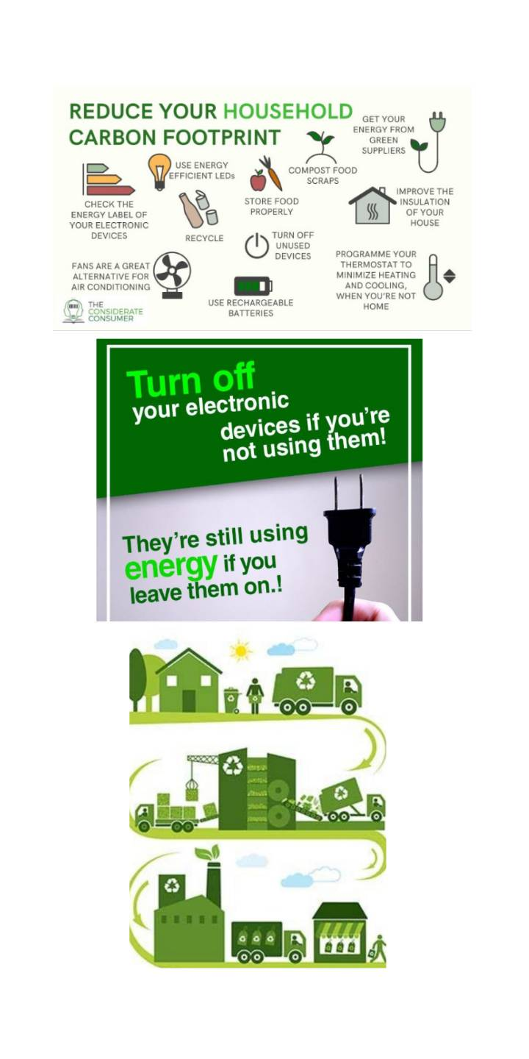
WANT BIG IMPACT?
USE BIG IMAGE.

Slide 13
THANK YOU

